Slide 1
Does Early Infant Male Circumcision Increase Mothers’ Attendance for Postnatal Care Services? Findings from Iringa, Njombe, and Tabora Regions, Tanzania
by: Michael David Machaku¹, Zebedee Mwandi¹, Augustino Hellar¹,
Alice Christensen¹, Mary Drake¹, Maende Makokha¹, Gaspar Mbita¹, Abdallah Maganga¹, Thomas Maokola¹, Alex Kapula¹, Mariam Mohamed², Faraja Kotta², Robert Salim2, Gissenge Lija³, Jeremiah Mushy³, and Erick Mlanga⁴
affiliation: ¹Jhpiego; ²Iringa , Njombe and Tabora Regional Authority; ³National AIDS Control Programme; ⁴US Agency for International Development

Slide 2
No conflicts of interest to declare

Slide 3
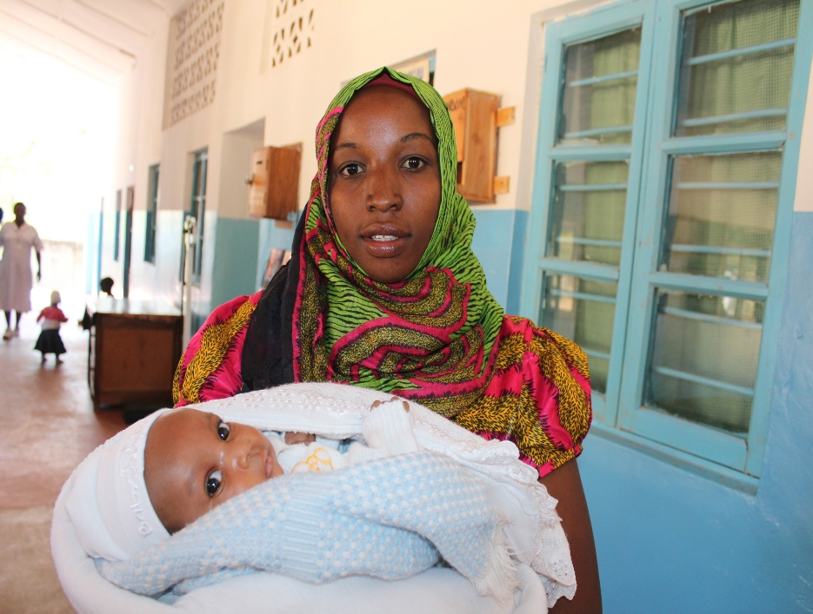
Background
The World Health Organization (WHO) recommends at least four postnatal care (PNC) visits in the 6-week postpartum period.
Most maternal and neonatal deaths occur during the postpartum period.
The maternal mortality ratio in Tanzania is 556 per 100,000.
Neonatal deaths are 42/1,000 live births²
In Tanzania
only 37% of mothers who give birth reported seeing someone for a checkup after birth.¹
women who deliver in a health facility are more likely to have had a postnatal health checkup within 2 days of delivery than those who had a non-facility delivery (50% versus 6%).¹
¹ Tanzania Demographic Health Survey, 2015/6
² Tanzania Demographics Profile 2018
A mother delivered at home and came for early infant male circumcision. Photo by Owen Mwandumbya, Jhpiego.

Slide 4
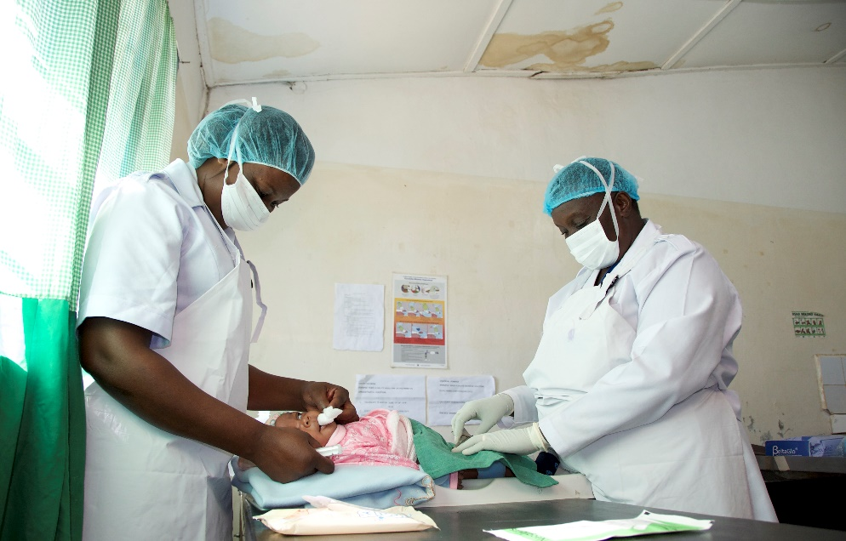
Background
Voluntary medical male circumcision (VMMC) is a proven biomedical intervention that provides partial protection against HIV acquisition.
In 2011, WHO and UNICEF recommended that early infant male circumcision (EIMC) be introduced when countries reach high circumcision coverage rates in adolescents and adults.
EIMC is a long-term strategy to maintain high circumcision coverage in areas with high HIV prevalence.
In Tanzania, EIMC was piloted in 2013 and scaled up in three high HIV prevalence regions from 2014–2018.
Iringa (10.3%), Njombe (11.4%), and Tabora (5.1%).¹
¹THIMS 2016–17
Reproductive and child health providers preparing infant for procedure. Photo by Jhpiego.

Slide 5
Hypothesis
We hypothesized that facilities with the EIMC program, would have higher proportions of infants born at home coming for PNC services when compared to facilities which were without the EIMC program.

Slide 6
VMMC Priority Regions in Tanzania

Slide 7
EIMC Scale-Up Timeline in Tanzania
VMMC pilot, Iringa
2010
2013
EIMC pilot, Iringa
2014
EIMC introduced in Iringa
2016
2017
EIMC introduced in Njombe
2009
VMMC scale-up
EIMC introduced in Tabora
Morogoro and Singida
VMMC and EIMC scale-up

Slide 8
EIMC Service Delivery Model
Community workers provide education within the communities and referral for EIMC services. They target all infants-those born at facilities and at home
Parents of eligible male infants ages 24 hours to 60 days are educated about EIMC in group education.
Providers in reproductive and child health (RCH) services are trained in EIMC services.
Integration allows for one-stop services for parents and their infants.
RCH
Immunization
EIMC
Triage: weight
Postpartum
Family planning
Prevention of mother-to-child transmission

Slide 9
Methods
Conducted a retrospective data review of national DHIS2 database from 36 health facilities that offer EIMC services between October 2016 and September 2018.
Identified number of infants who had EIMC versus no EIMC
Assessed all infants that received PNC services to determine the number of babies who were born at home.
Compared the percentages of infants born at home that had EIMC versus percentage of infants born at home that did not have EIMC services and compared using a two population z-test.

Slide 10
Number of EIMC sites
36
60,963 Infants Attended PNC
60,963 Infants Attended PNC
8,748 infants received EIMC
52,215 infants did not received EIMC
Born at home
298 (3.4%)
Born at home
819 (1.6%)

Slide 11
Results
Among infants born at home, those who accessed EIMC services were more likely to attend PNC services than those who did not access EIMC services (p<0.0001, z>11.54)

Slide 12
Conclusion
Community and facility EIMC advocacy activities encourage parents to bring infants to PNC services for EIMC. Offering EIMC services may be a catalyst to increase rates of PNC service uptake, especially for those infants born at home.
Looking at demand for EIMC services alongside other factors to increase postpartum care rates can help support good outcomes of mothers and babies in the postnatal care period.

Slide 13
Acknowledgments
Jhpiego
John Snow Inc., AIDSFree
Regional Health Authorities, Iringa, Njombe, and Tabora
Ministry of Health, Community Development, Gender, Elderly, and Children
US Agency for International Development, Tanzania
This presentation is made possible by the generous support of the American people through the US President’s Emergency Plan for AIDS Relief (PEPFAR) with the US Agency for International Development (USAID) under the Cooperative Agreement Strengthening High Impact Interventions for an AIDS-free Generation, number AID-OAA-A-14-00046. The information does not necessarily reflect the views of USAID, PEPFAR, or the US Government.

